Slide 2
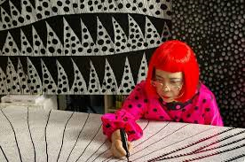
Yayoi Kusama 草間彌生
Yayoi Kusama (草間 彌生 or 弥生, Kusama Yayoi, born March 22, 1929) is a Japanese artist and writer. Throughout her career she has worked in a wide variety of media, including painting, collage, soft sculpture, performance art, and environmental installations, most of which exhibit her thematic interest in psychedelic colors, repetition, and pattern. A precursor of the pop art, minimalist and feminist art movements, Kusama influenced her contemporaries such as Andy Warhol, Claes Oldenburg, and George Segal and exhibited works alongside the likes of them.
From Wikipedia: https://en.wikipedia.org/wiki/Yayoi_Kusama
Yayoi Kusama Official Site http://www.yayoi-kusama.jp/
Yayoi Kusama – Obsessed with Polka Dots https://www.youtube.com/watch?v=rRZR3nsiIeA

Slide 3
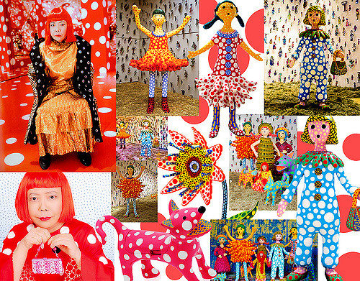
Outline
Grammar
Words and Phrases
Conversation
Role-play
Activities

Slide 4
現在簡單式 (Present Simple Tense)
現在簡單式，又稱現在式，現在簡單式通常用於表示現在的事實或狀態、現在的習慣或固定會做的事情、真理、格言或普遍認知的事實。
We offer three kinds of guided tours.
It shows the locations for permanent exhibitions and special exhibitions.
She is not only an avant-garde artist, but she is also a sculptor and novelist.

Slide 5
Words and Phrases -1
1. exhibition n. 展覽
I learned a lot about Chinese art at the exhibition.
我在這個展覽中學到很多關於中國藝術的知識。
2. Kusama’s Exhibit: A Dream I Dreamed 草間彌生展覽：夢我所夢
3. audio guide n. 語音導覽
The interactive audio guide is available in five languages.
那個互動式的語音導覽有五種語言可供選擇。
4. permanent adj. 永久的；持久的
The ink was not permanent, so I could wash it off easily.
這墨水並不持久，所以我可以輕易洗掉它。

Slide 6
Words and Phrases -2
5. deposit n. 押金
If you break anything, you will lose your cash deposit.
如果你損壞任何物品的話，你就無法拿回押金。
6. brochure n. 小冊子
I have a few brochures about different computers, as I’m planning to buy a new one.
我有幾本介紹不同電腦的小冊子，因為我打算買台新電腦。
7. prohibit v. 禁止
Smoking is prohibited in public buildings in Taiwan.
在台灣，在公共大樓裡吸菸是禁止的。
8. polka dot n. 圓點花樣
She wore a pink dress with white polka dots to the party.
她穿了一件帶有白色圓點花紋的粉紅洋裝去參加派對。

Slide 7
Words and Phrases -3
9. fascinate v. 強烈的吸引；使人神魂顛倒
Kristen was fascinated with the beautiful jewels on display in the museum.
克莉絲坦深深被博物館裡展出的美麗珠寶吸引。
10. signature n. 特徵；識別物；簽名
The sad songs that this band plays are its signature.
那個樂團所演奏的這些悲傷歌曲是他們的招牌。
11. represent v. 作為……的代表；象徵
Sarah represented her class when she ran for student president at school.
莎拉代表她班上參加學校學生會會長的競選。
12. infinity n. 無限，無窮
The immense desert seems to stretch into infinity.
那個浩瀚的沙漠似乎延綿不絕。

Slide 8
Words and Phrases -4
13. avant-garde adj. 前衛的
The avant-garde director is known for experimenting with new techniques in his films.
那位前衛的導演以在電影中實驗新技巧而聞名。
14. collage n. 美術拼貼
The artist constructs collage using photographs of her own face.
那位藝術家用她自己的臉部照片製作美術拼貼。
15. performance art n. 行為藝術
Common types of performance art include music, dance, literature, and design.
常見的行為藝術類型包含音樂、舞蹈、文學以及設計。

Slide 9
Words and Phrases -5
16. installation art n. 裝置藝術
Many subway stations in Stockholm have been decorated with sculptures, paintings, and installation art.
斯德哥爾摩的許多地下鐵車站都裝飾有雕塑、繪畫與裝置藝術。
17. psychedelic adj. 迷幻的
Psychedelic art features bright and highly contrasting colors.
迷幻藝術的特色是使用明亮且具有高度對比的色彩。
18. repetition n. 重複；反覆
A good writer uses a variety of grammatical structures and vocabulary to avoid repetition.
一位好的作家會使用各種不同的文法結構與詞彙來避免重複。

Slide 10
Words and Phrases -6
19. catch on to phr. 理解；領會
It took me a while to catch on to Peter’s joke.
我過一會兒才理解彼得的笑話。
20. masterpiece n. 傑作；名作
The artist’s latest painting is a masterpiece.
這位藝術家的最新畫作是個傑作。
21. mosaic adj. 馬賽克的；鑲嵌的；馬賽克式的
Mosaic tiles are often used in decorative art or as interior decoration.
馬賽克瓷磚時常用在裝飾藝術或作為室內裝潢。

Slide 11
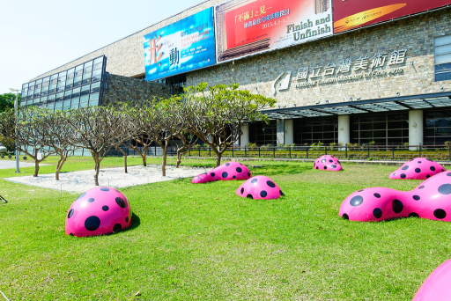
Conversation
Brent and Emma visit National Taiwan Museum of Fine Arts to see Kusama’s Exhibit: A Dream I Dreamed. They are now at the information desk of the museum. Brent is asking the information desk assistant some questions about the museum and the exhibition.
Mick: information desk assistant

Slide 14
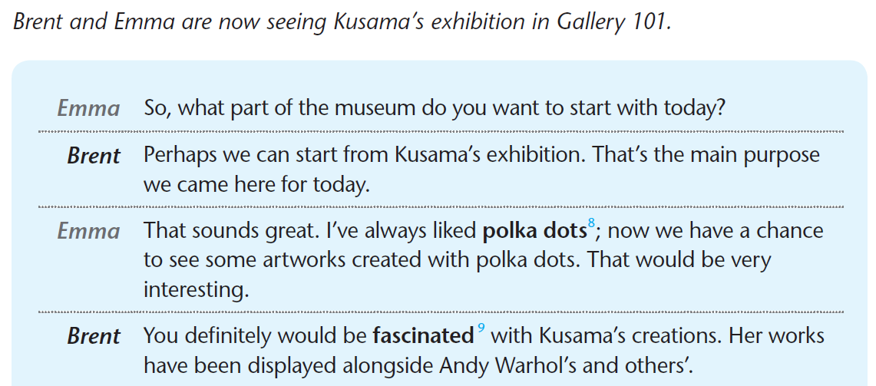

Slide 15
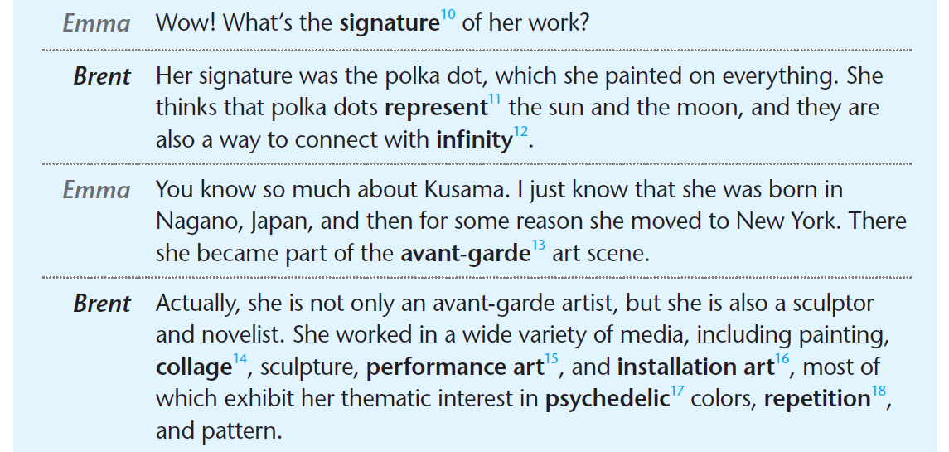

Slide 17
Role-play
Practice the conversation with your partner.

Slide 18
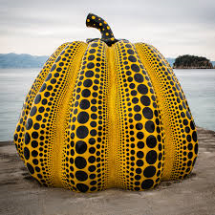
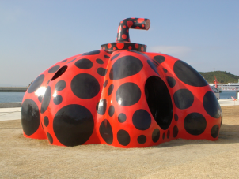
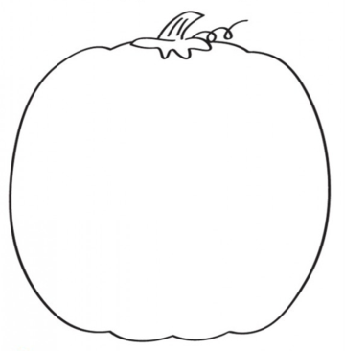
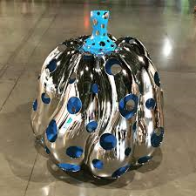
Activities
Design a Kusama’s style pumpkin.

Slide 19
References
Collage
Performance Art
Installation Art
Psychedelic Art
Mosaic

Slide 20
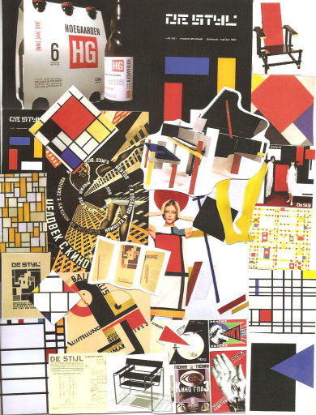
Collage 拼貼畫
Collage is a technique of an art production, primarily used in the visual arts, where the artwork is made from an assemblage of different forms, thus creating a new whole.
A collage may sometimes include magazine and newspaper clippings, ribbons, paint, bits of colored or handmade papers, portions of other artwork or texts, photographs and other found objects, glued to a piece of paper or canvas.
The origins of collage can be traced back hundreds of years, but this technique made a dramatic reappearance in the early 20th century as an art form of novelty.
From Wikipedia: https://en.wikipedia.org/wiki/Collage

Slide 21
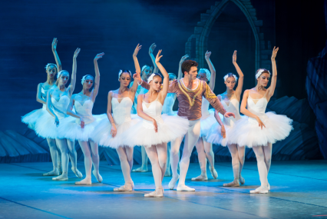
Performance Art 行為藝術
Performance art is a performance presented to an audience within a fine art context, traditionally interdisciplinary.
The performance can be live or via media; the performer can be present or absent. It can be any situation that involves four basic elements: time, space, the performer's body, or presence in a medium, and a relationship between performer and audience.
Performance art can happen anywhere, in any type of venue or setting and for any length of time. The actions of an individual or a group at a particular place and in a particular time constitute the work.
From Wikipedia: https://en.wikipedia.org/wiki/Performance_art

Slide 22
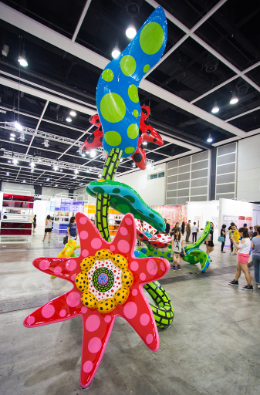
Installation Art 裝置藝術
Installation art is an artistic genre of three-dimensional works that often are site-specific and designed to transform the perception of a space. Generally, the term is applied to interior spaces, whereas exterior interventions are often called public art, land art or intervention art; however, the boundaries between these terms overlap.
From Wikipedia: https://en.wikipedia.org/wiki/Installation_art

Slide 23
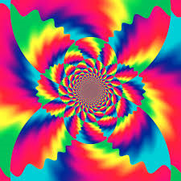
Psychedelic Art 迷幻藝術
Psychedelic art is any art or visual displays inspired by psychedelic experiences and hallucinations known to follow the ingestion of psychoactive drugs such as LSD and psilocybin.
From Wikipedia: https://en.wikipedia.org/wiki/Psychedelic_art

Slide 24
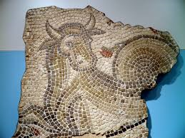
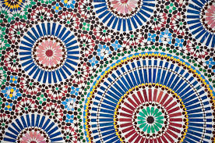
Mosaic 馬賽克
A mosaic is a piece of art or image made from the assemblage of small pieces of colored glass, stone, or other materials. It is often used in decorative art or as interior decoration. Most mosaics are made of small, flat, roughly square, pieces of stone or glass of different colors, known as tesserae. Some, especially floor mosaics, are made of small rounded pieces of stone, and called "pebble mosaics". Others are made of other materials.
From Wikipedia: https://en.wikipedia.org/wiki/Mosaic

